Slide 1


JTree komponenta
Laboratorija za softversko inženjerstvo
Profesor:
Dr Miloš Milić
Student:
Stefan Veljković 2019/1030

Slide 2

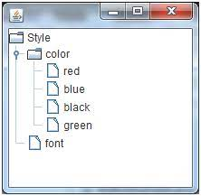
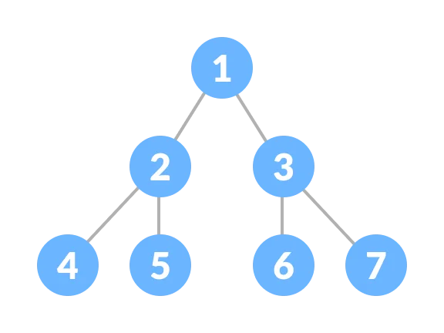
Čemu služi JTree komponenta?
JTree komponenta služi da predstavi podatke koji su hijerarhijski poređani, odnosno podaci su poređani u strukturu koje se zove stablo.
NAPOMENA: Jtree komponenta ne sadrži strukturu podataka nego samo predstavlja kako su podaci raspoređeni u stablu !!!

Slide 3
Kako se koristi Jtree komponenta?
Korišćenjem DefaultTreeModel i DefaultMutableTreeNode klasa
Proširenjem DefaultTreeModel i DefaultMutableTreeNode klasa
Implementacijom TreeModel interface-a

Slide 4
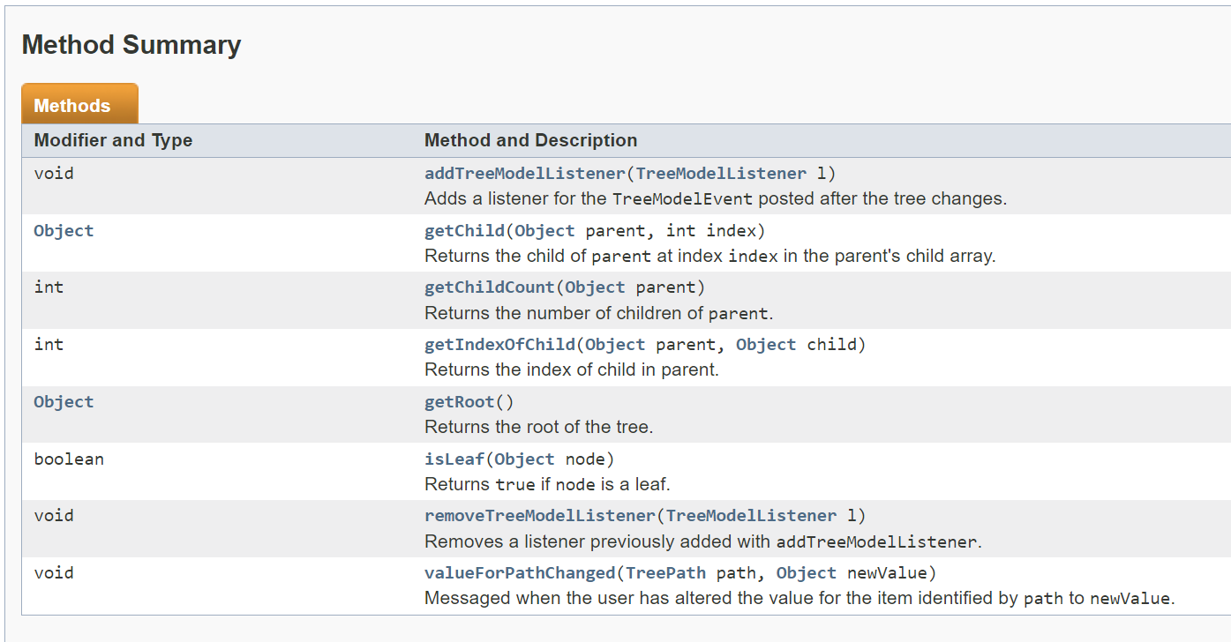
Pre nego što krenemo ….
<<Interface>> TreeModel
<<Class>> DefaultTreeModel

Slide 5
Pre nego što krenemo ….
<<Interface>> TreeModel
<<Class>> DefaultTreeModel
public class DefaultTreeModel extends Object implements Serializable, TreeModel
Polja:
protected boolean asksAllowsChildren Determines how the isLeaf method figures out if a node is a leaf node.
Protected EventListenersList listenersList Listeners
protected TreeNode root Root of the tree.
Kontruktori:
DefaultTreeModel(TreeNode root) Creates a tree in which any node can have children.
DefaultTreeModel(TreeNode root, boolean asksAllowsChildren) Creates a tree specifying whether any node can have children, or whether only certain nodes can have children.

Slide 6
Pre nego što krenemo ….
<<Interface>> TreeModel
<<Class>> DefaultTreeModel
Metode koje ćemo koristiti iz DefaultTreeModel klase:
reload(TreeNode node): void Invoke this method if you've modified the TreeNodes upon which this model depends.

Slide 7
Pre nego što krenemo ….
<<Interface>> TreeNode
<<Interface>> MutableTreeNode
<<Class>> DefaultMutableTreeNode
public Interface TreeNode
Metode koje ćemo koristiti:
isLeaf():Boolean Returns true if the receiver is a leaf.
getParent(): TreeNode Returns the parent TreeNode of the receiver.

Slide 8
Pre nego što krenemo ….
<<Interface>> TreeNode
<<Interface>> MutableTreeNode
<<Class>> DefaultMutableTreeNode
public interface MutableTreeNode extends TreeNode
Metode koje ćemo koristiti:
remove(MutableTreeNode node):void Removes node from the receiver.
setUserObject(Object object):void Resets the user object of the receiver to object.

Slide 9
Pre nego što krenemo ….
<<Interface>> TreeNode
<<Interface>> MutableTreeNode
<<Class>> DefaultMutableTreeNode
public class DefaultMutableTreeNode extends Object implements Cloneable, MutableTreeNode, Serializable
Polja:
protected Boolean allowsChildren true if the node is able to have children
protected Vector children array of children, may be null if this node has no children
static Enumeration<TreeNode> EMPTY_ENUMERATION An enumeration that is always empty.
protected MutableTreeNode parent this node's parent, or null if this node has no parent
protected Object userObject optional user object

Slide 10
Pre nego što krenemo ….
<<Interface>> TreeNode
<<Interface>> MutableTreeNode
<<Class>> DefaultMutableTreeNode
Kontruktori:
DefaultMutableTreeNode() Creates a tree node that has no parent and no children, but which allows children.
DefaultMutableTreeNode(Object userObject) Creates a tree node with no parent, no children, but which allows children, and initializes it with the specified user object.
DefaultMutableTreeNode(Object userObject, boolean allowsChildren) Creates a tree node with no parent, no children, initialized with the specified user object, and that allows children only if specified.

Slide 11
Pre nego što krenemo ….
<<Interface>> TreeNode
<<Interface>> MutableTreeNode
<<Class>> DefaultMutableTreeNode
Metode koje ćemo koristiti:
add(MutableTreeNode newChild): void Removes newChild from its parent and makes it a child of this node by adding it to the end of this node's child array.
getParent(): TreeNode Returns this node's parent or null if this node has no parent.
getPath(): TreeNode[] Returns the path from the root, to get to this node.
isLeaf(): boolean Returns true if this node has no children.
remove(MutableTreeNode aChild) Removes aChild from this node's child array, giving it a null parent.
setUserObject(Object userObject): void Sets the user object for this node to userObject.
toString(): String Returns the result of sending toString() to this node's user object, or the empty string if the node has no user object.

Slide 12
Krećemo da kucamo ✈️ Hvala na pažnji

